Slide 1
19CS3113S
Analysis and Design of Algorithms
Session -33

Slide 2
Basic Concepts
The computing times of algorithms fall into two groups.
Group1– consists of problems whose solutions are bounded by the polynomial of small degree. Example – Binary search O(logn) , sorting O(nlogn), matrix multiplication O(n^{2.81}).
Group2 – contains problems whose best known algorithms are non polynomial. Example –Traveling salesperson problem 0(n²2^{n}), knapsack problem 0(2^{n/2} ) etc.

Slide 3
There are two classes of non polynomial time problems
1. NP-Complete- have the property that it can be solved in polynomial time if all other NP-Complete problems can be solved in polynomial time.
2. NP-Hard- if it can be solved in polynomial time then all NP-Complete can be solved in polynomial time.
“All NP-Complete problems are NP-Hard but not all NP Hard problems are not NP-Complete”.

Slide 4
DETERMINISTIC AND NON DETERMINISTIC ALGORITHMS
Algorithms with the property that the result of every operation is uniquely defined are termed deterministic.
Such algorithms agree with the way programs are executed on a computer.
When the outcome is not uniquely defined but is limited to a specific set of possibilities, we call it non deterministic algorithm
To specify such algorithms in SPARKS, we introduce three statements
i) choice (S) : arbitrarily chooses one of the elements of the set S.
ii) failure : Signals an unsuccessful completion.
iii) Success : Signals a successful completion.

Slide 5
Example of a deterministic algorithm
Algorithm Lsearch(A,n,x)
{
for i:= 1 to n do
{
if(a[i]=x) then
return i;
}
return 0;
}

Slide 6
Example of a non deterministic algorithm
Algorithm Search(A,n,x)
{
j:= choice(1,n);
if(a[j]=x) then
{
return j;
succes();
}
return 0;
Failure();
}

Slide 7
Definitions
Decision problem
  Any problem whose answer is yes or no
Decision algorithm
  An algorithm for a decision problem is termed as a decision algorithm
Optimization problem
  Any problem that involves the identification of an optimal(either minimum or maximum) values of a given cost function is known as an optimization problem.
Optimization algorithm
  An optimization algorithm is used to solve an optimization problem.

Slide 8
P is the set of all decision problems solvable by a deterministic algorithm in polynomial time.
Sample Problems in P :
Fractional Knapsack, MST , Sorting.
NP is the set of all decision problems solvable by a nondeterministic algorithm in polynomial time.
Sample Problems in NP :
Fractional Knapsack, MST , Sorting and Hamiltonian Cycle (Traveling Salesman), Graph Coloring

Slide 9
Satisfiability
Let x1 ,x2 ,x3….xn denotes Boolean variables.
Let ¯x_{i} denotes the negation of x_{i} .
A literal is either a variable or its negation.
A formula in the prepositional calculus is an expression that can be constructed using literals and the operators ᴧ(AND) and v(OR).

Slide 10
A formula is in conjunctive normal form (CNF) iff it is represented as ᴧC_{i} , where the C_{i} are clauses each represented as Vl_{ij}.
It is in disjunctive normal form (DNF) iff it is represented as VC_{i} and each clause is represented as ᴧl_{ij}
The satisfiability problem is to determine if a formula is true for some assignment of truth values to the variables
CNF-Satisability is the satisfiability problem for CNF formulas

Slide 11
Algorithm for satisfiability
Algorithm EVAL(E, n)
{
for i := 1 to n do
xi := choice(true, false);
if E(x1 ,...,xn)
then success();
else failure();
}

Slide 12
Reducibility
Let L₁ and L₂ be problems. L₁ reduces to L₂ (L₁ α L₂) if and only if there is a deterministic polynomial time algorithm to solve L₁ that solves L₂ in polynomial time.
If L₁ α L₂ and L₂ α L₃ then L₁ α L₃.
COOK’s Theorem
Satisfiability is in P if and only if P = NP.
NP-Hard
A problem L is NP-hard if any only if satisfiability reduces to L.
NP-complete
A problem L is NP-complete if and only if L is NP-hard and L є NP.

Slide 13
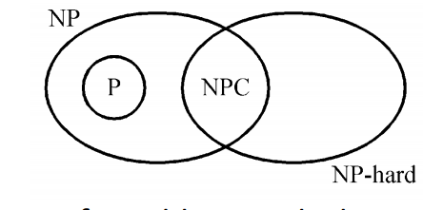
Relationship between P,NP,NP-Hard and NP-Complete

Slide 14
COOK’S THEOREM
Theorem states that satisfiability is in P if and only if P = NP.
To prove this, we show how to obtain from any polynomial time nondeterministic decision algorithm A and input I a formula Q(A, I) such that Q is satisfiable iff A has a successful termination with input I.
If the length of I is n and the time complexity of A is p(n) for some polynomial p(), then the length of Q is O(p³(n) logn) = O(p⁴(n)).

Slide 15
The time needed to construct Q is also O(p³(n)log n).
A deterministic algorithm Z to determine the outcome of A on any input I can be easily obtained.
Algorithm Z simply computes Q and then uses a deterministic algorithm for the satisfiability problem to determine whether Q is satisfiable.
If O(q(m)) is the time needed to determine whether a formula of length m is satisfiable, then the complexity of Z is O(p³(n) logn + q(p³(n) logn)).

Slide 16
If satisfiability is in P, then q(m) is a polynomial function of m and the complexity of Z becomes O(r(n)) for some polynomial r(). Hence, if satisfiability is in P, then for every nondeterministic algorithm A in NP we can obtain a deterministic Z in P.
So, the above construction shows that if satisfiability is in P, then P = NP.

Slide 17
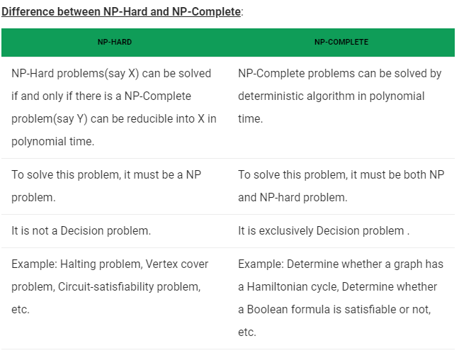

Slide 18
Example : Halting problem is NP-hard decision problem, but it is not NP-complete.
Halting problem is NP-hard
To show that Halting problem is NP-hard, we show that satisfiability α halting problem.
For this let us construct an algorithm A whose input is a prepositional formula X.
- Suppose X has n variables.
- Algorithm A tries out all 2^{n} possible truth assignments and verifies if X is satisfiable.
Halting problem is un-decidable.
- Hence there exists no algorithm to solve this problem.
- So, it is not in NP. Therefore, it is not NP-complete.

Slide 19
Thank you

